Slide 1
ICT1008 Data Structures and Algorithms Lecture 1a: Introduction
Notes:
8 mins self - introduction

Slide 2
Agenda & Learn Outcomes
Agenda
Course Introduction
Motivations
Schedule & Assessments
1st Half Learning Outcomes
To analyze the order of growth of time and space complexity of algorithms using Big-Oh notation.
To describe and differentiate various algorithmic approaches such as recursion, divide and conquer, greedy, backtracking and dynamic programming.
To evaluate and select appropriate algorithms and data structures for solving problems, such as sorting
To implement algorithms and data structures for solving problems.

Slide 3
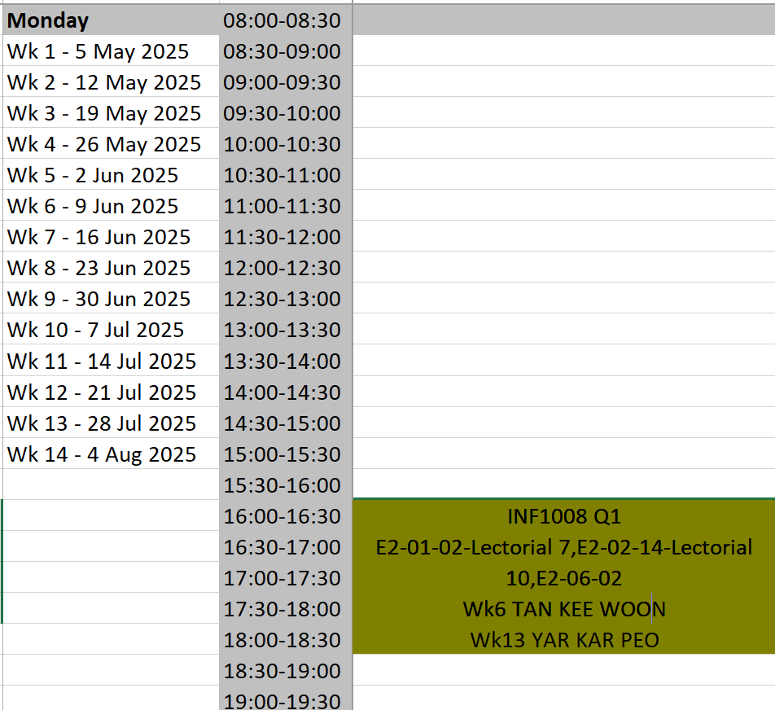
Assessment Weightage
Lab 10%
No tutorial on week 1
Assignment – 20%
Quiz 1 – 35%
(wk 6, monday)
Quiz 2 – 35%
(wk 13, monday)

Slide 4
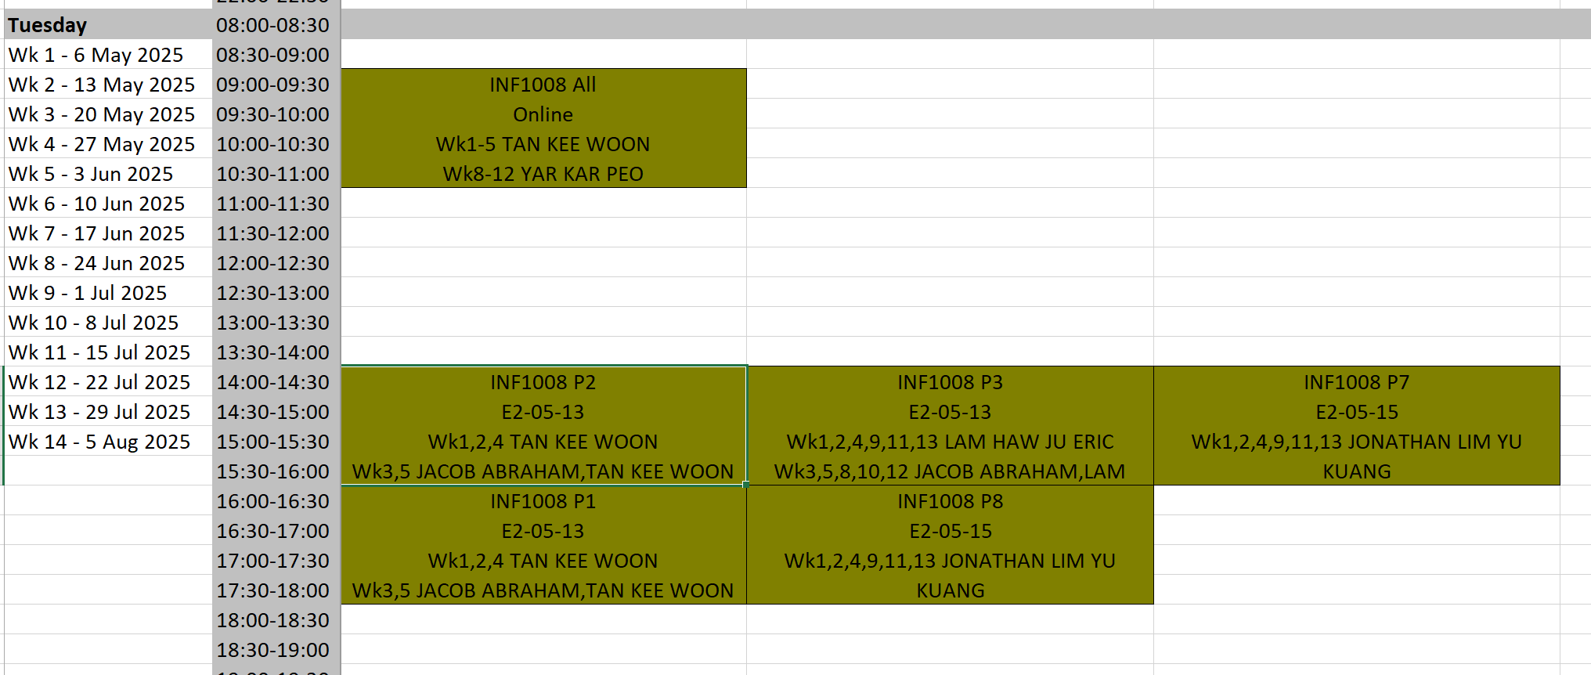
Lab Schedule
Note: No tutorial on week 1

Slide 5
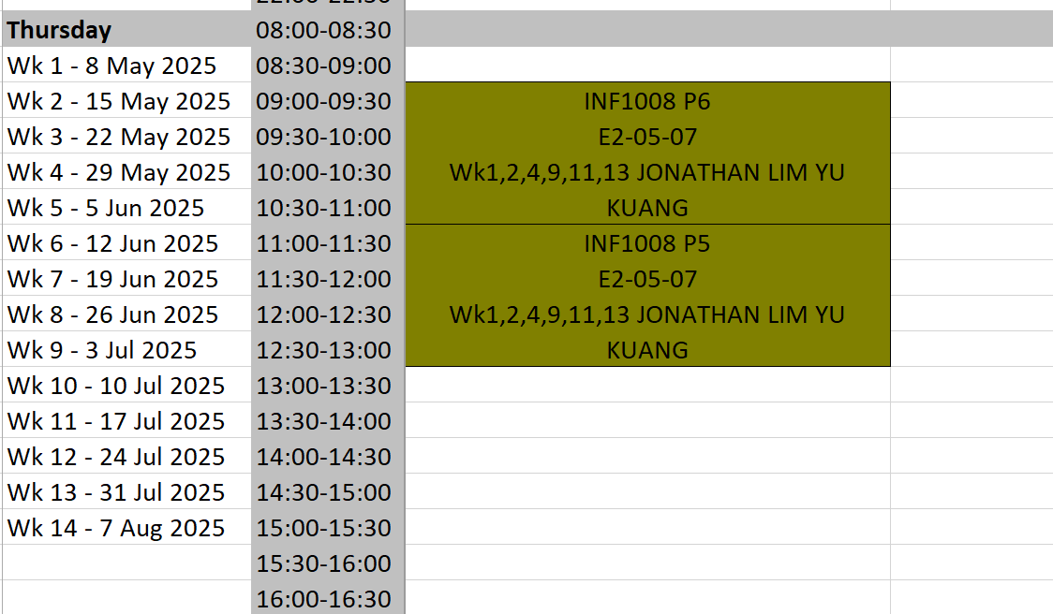
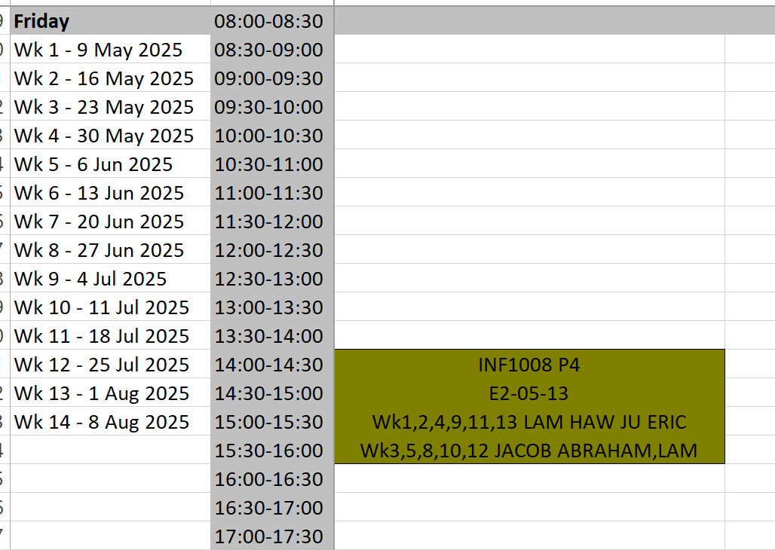
Lab Schedule
Note: No tutorial on week 1

Slide 6
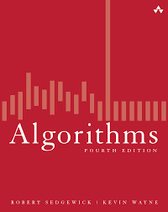
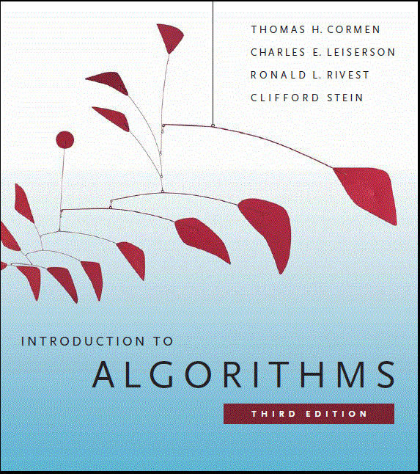
Resources (Textbook)
Algorithms
by Robert Sedgewick and Kevin Wayne.
Addison-Wesley Professional.
4th edition, 2011.
The site for the book is at:
http://algs4.cs.princeton.edu/home
Introduction to Algorithms
by Thomas H. Cormen, Charles E. Leiserson, Ronald L. Rivest and Clifford Stein.
The MIT Press. 3rd edition, 2009.
Online Resource:
http://ocw.mit.edu/courses/electrical-engineering-and-computer-science/6-046j-introduction-to-algorithms-sma-5503-fall-2005/
http://ocw.mit.edu/courses/electrical-engineering-and-computer-science/6-006-introduction-to-algorithms-fall-2011/
Notes:
3 minutes on text books and online resources

Slide 7
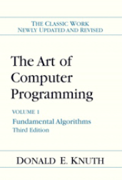
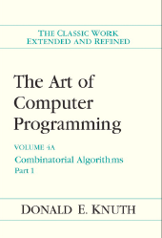
Resources (Reference Books)
The Art of Computer Programming, Volumes 1-4A Boxed Set by Donald E. Knuth. Addison-Wesley Professional. 1st edition, 2011.
Many other good free resources are available online
Ebook by Clifford A. Shaffer: Data Structures and Algorithm Analysis http://people.cs.vt.edu/~shaffer/Book/

Slide 8
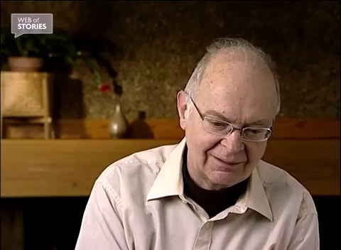
Why study algorithms?
“ An algorithm must be seen to be believed. ” - Knuth
Notes:
LKK: 3m video – Donald Knuth on his lifelong interest in studying algorithms.

Slide 9
Why study algorithms?
Their impact is broad and far-reaching.
Internet. Web search, packet routing, distributed file sharing, ...
Biology. Human genome project, protein folding, …
Computers. Circuit layout, file system, compilers, …
Computer graphics. Movies, video games, virtual reality, …
Security. Cell phones, e-commerce, voting machines, …
Multimedia. MP3, JPG, DivX, HDTV, face recognition, …
Social networks. Recommendations, news feeds, advertisements, …
Physics. N-body simulation, particle collision simulation, …
Notes:
Learning how to think
Thinking as in Logical Thinking
Why not many make decision in a logical manner
Biologically difficult
Feelings

Slide 10
Algorithm
Definition: Finite sequence of rules/instructions for carrying out some calculation or procedure
Properties:
Correct
Terminate
Efficient: time, space

Slide 11
Properties of Algorithms
Correctness
As with a theorem, it is easy to show an algorithm is incorrect: just find a case where the algorithm fails.
Showing that an algorithm is correct is much more difficult.
Care in defining the solution domain can help with proving correctness.
Correctness can be shown:
Formally - formal methods.
Informally - programming & testing.

Slide 12
Properties of Algorithms
Efficiency
Usually this is a measure of speed: how many instructions are needed?
Sometimes it is a measure of space: how much storage is needed?
Rarely, it is a measure of some other property or combination of properties.
Performance
Cost associated with the implementation
Energy consumption
Notes:
CPU consumption
RAM consumption

Slide 13
Data Structures
Data structures – more than just data?
Organised collection of data
Represent an abstract data type in an efficient (hopefully) way
Allow for efficient access by the algorithm
Use minimum storage
Data Structures and Algorithm
Algorithm operate on Data Structures
Data Structure contains information about the system state at a point in time
Algorithm describes the capability or uses of the system
Choose the right data structures and algorithms for a problem

